Slide 1
Project Integration Management
By
Humaira Afzal
Lecturer CS, CUI Lahore Campus

Slide 2
Knowledge Area
There are 10 knowledge areas in Project management that represents the key aspects of project management such as cost, time, risk, communication ..etc.
These Knowledge Areas provides the specialized knowledge needed for different aspects of project management.
Each Knowledge Area consist of processes that focus on specific project objective.
These processes are distributed across the 5 process groups and 10 Knowledge Areas.

Slide 3
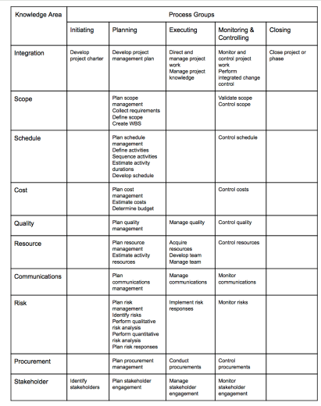

Slide 4
Project Integration
Project Integration Management includes the processes and activities to identify, deﬁne, combine and coordinate the various processes and project management activities within the Project Management Process Groups.
Project integration management is the coordination of all elements of a project.
These actions should be applied from the start of the project through completion.

Slide 5
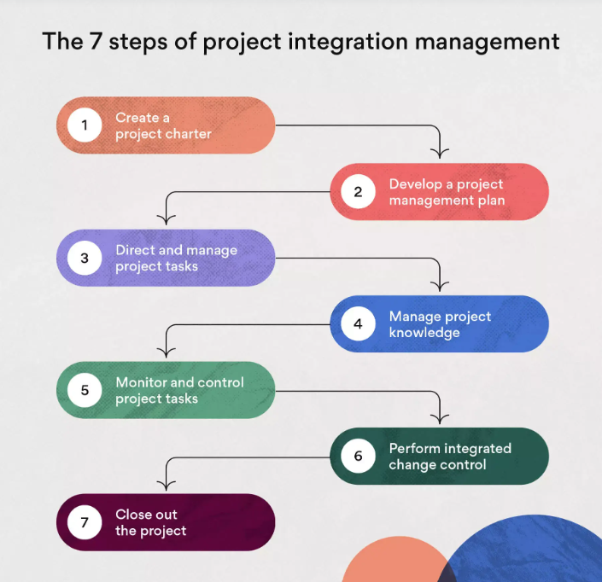
Project Integration Management processes

Slide 6
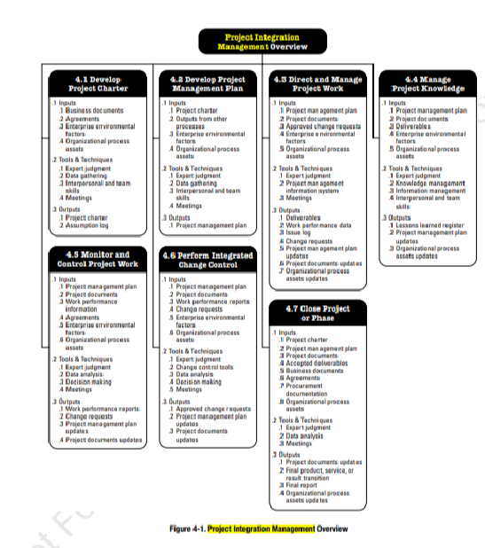

Slide 7
DEVELOP PROJECT CHARTER
The process of developing a document that formally authorizes the existence of a project and provides the project manager with the authority to apply organizational resources to project activities.
Inputs:
Project Statement of work: is a description of products, services, or results to be delivered by a project.
The business case describes the necessary information from a business standpoint to determine whether the expected outcomes of the project justify the required investment.
A Contract is used when a project is being performed for an external customer.

Slide 8
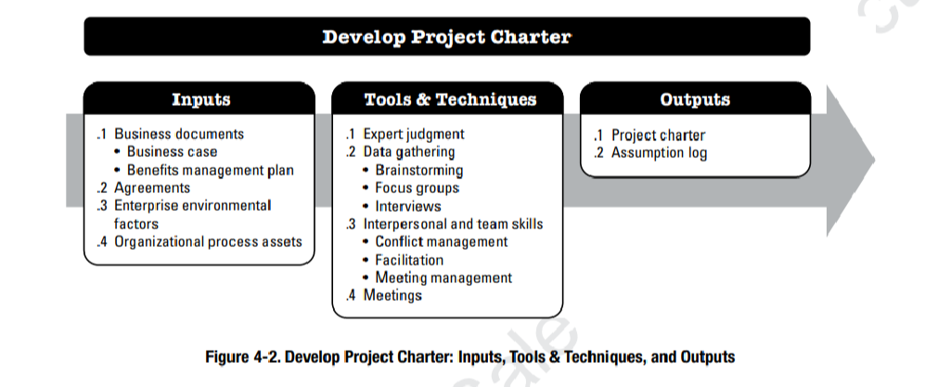

Slide 9
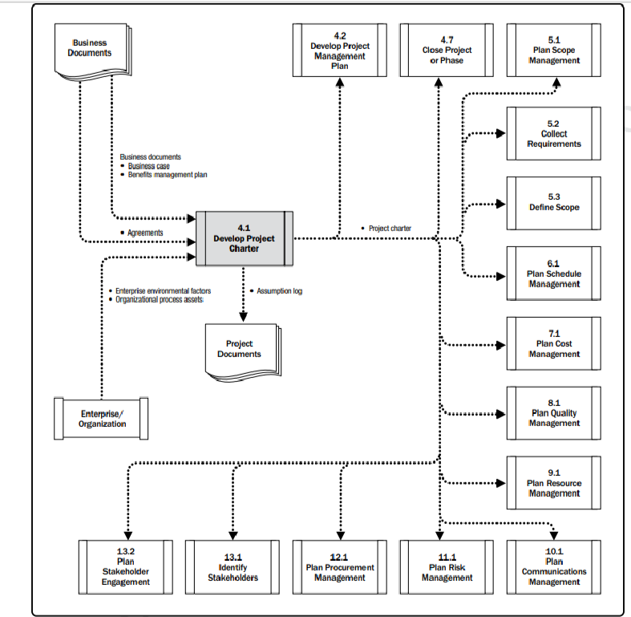

Slide 10
DEVELOP PROJECT CHARTER
Project Charter documents the high-level information on the project and the product, service, or result the project is intended to satisfy.
Project purpose or Justification.
High-level Project description and boundaries.
Measurable Project Objectives and related success criteria.
Summary milestones (high-level schedule)
Summary budget
Approval requirements
Assigned project manager, responsibility, and authority level
Name and authority of the sponsor or other person(s) authorizing the project charter.
Notes:
Project approval requirements (i.e, What constitutes project success, who decides the project is successful, and who signs off on the project)

Slide 11
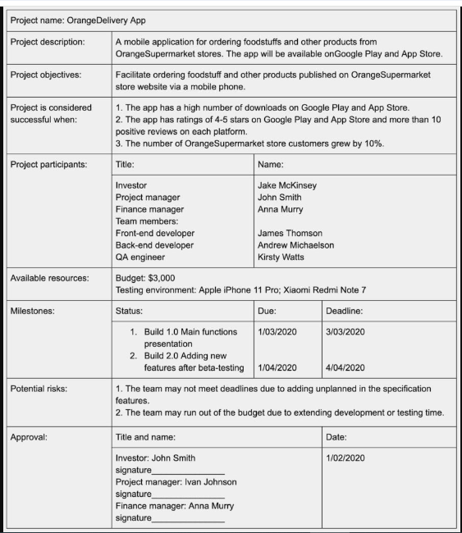

Slide 12
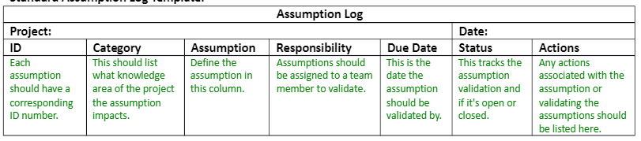
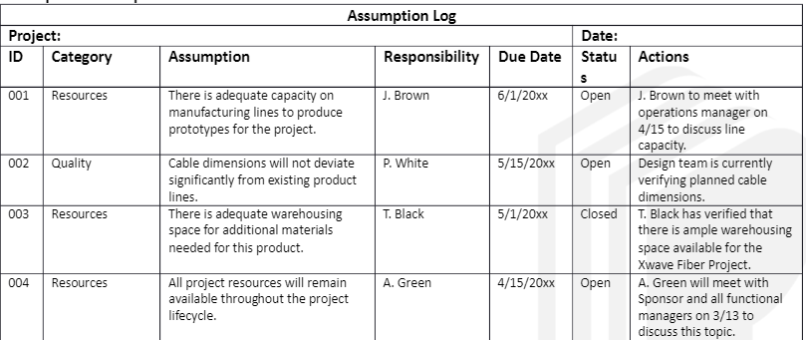
ASSUMPTION LOG
The assumption log is used to record all assumptions and constraints throughout the project life cycle.

Slide 13
DEVELOP PROJECT MANAGEMENT PLAN
Develop Project Management Plan is the process of defining, preparing, and coordinating all plan components and consolidating them into an integrated project management plan.
Project performance should be measured against a baseline plan.

Slide 14
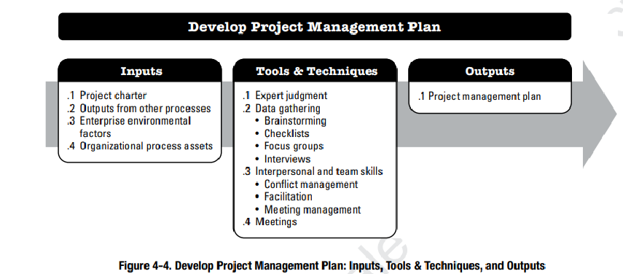

Slide 15
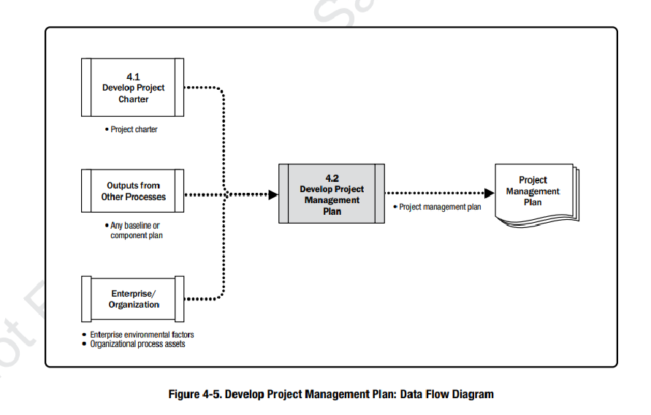

Slide 16
DEVELOP PROJECT MANAGEMENT PLAN: OUTPUTS
PROJECT MANAGEMENT PLAN
The project management plan is the document that describes how the project will be executed, monitored, controlled, and closed.
It integrates and consolidates all of the subsidiary management plans baselines, and other information necessary to manage the project.
Project management plan components include
Scope management plan
Requirements management plan.
Schedule management plan.
Cost management plan.
Quality management plan.
Resource, Communication, Risk, Procurement and stakeholder management plan.

Slide 17
DIRECT AND MANAGE PROJECT WORK
Direct and Manage Project Work is the process of leading and performing the work deﬁned in the project management plan and implementing approved changes to achieve the project’s objectives.

Slide 18
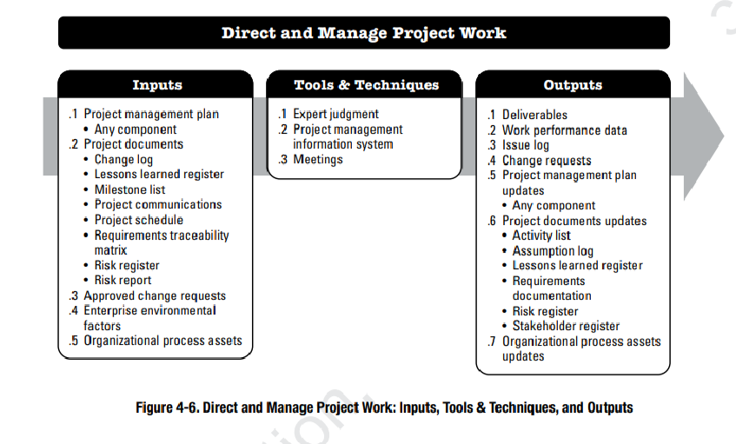

Slide 19
DIRECT AND MANAGE PROJECT WORK
Inputs:
Change log. The change log contains the status of all change requests.
Milestone list. The milestone list shows the scheduled dates for speciﬁc milestones.
Project communications. Project communications include performance reports, deliverable status, and other information generated by the project.
APPROVED CHANGE REQUESTS
Approved change requests are an output of the Perform Integrated Change Control process, and include those requests reviewed and approved for implementation by the project manager or by the change control board (CCB) when applicable.

Slide 20
DIRECT AND MANAGE PROJECT WORK: TOOLS AND TECHNIQUES
PROJECT MANAGEMENT INFORMATION SYSTEM (PMIS)
A PMIS is a software program or application that organizes and controls the flow of project data and information.

Slide 21
DIRECT AND MANAGE PROJECT WORK: OUTPUTS
1 DELIVERABLES
Deliverables are typically the outcomes of the project or phase.
2 WORK PERFORMANCE DATA
Examples of work performance data include work completed, key performance indicators (KPIs), actual start and ﬁnish dates of scheduled activities, deliverables status, schedule progress, and number of defects.
3 ISSUE LOG
Throughout the life cycle of a project, the project manager will normally face problems, gaps, inconsistencies, or conﬂicts that occur unexpectedly and that require some action so they do not impact the project performance.
Notes:
KPIs or Key Performance Indicators are measurable indicators used by a company or sector to compare and evaluate performance in achieving strategic and operational objectives.

Slide 22
DIRECT AND MANAGE PROJECT WORK: OUTPUTS
3 ISSUE LOG
The issue log is a project document where all the issues are recorded and tracked.
Issue type
Who raised the issue and when,
Description
Priority
Who is assigned to the issue
target resolution date
status, and
final solution.

Slide 23
DIRECT AND MANAGE PROJECT WORK: OUTPUTS
Project Documents Include:
Assumption log.
lessons learned register.
Requirements documentation.
Risk register.
Stakeholder register.
7. ORGANIZATIONAL PROCESS ASSETS UPDATES
Any organizational process asset can be updated as a result of this process.

Slide 24
PERFORM INTEGRATED CHANGE CONTROL
Perform Integrated Change Control is the process of reviewing all change requests; approving changes and managing changes to deliverables, project documents, and the project management plan; and communicating the decisions.
key beneﬁt
Manage Changes throughout the project cycle

Slide 25
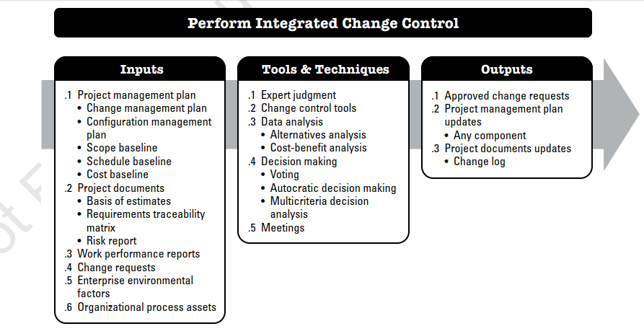
PERFORM INTEGRATED CHANGE CONTROL

Slide 26
PERFORM INTEGRATED CHANGE CONTROL: INPUTS
1 PROJECT MANAGEMENT PLAN
Change management plan. The change management plan provides the direction for managing the change control process and documenting the roles and responsibilities of the change control board (CCB).
Configuration management plan. The conﬁguration management plan describes the conﬁgurable items of the project. It identifies the items that will be recorded and updated so that the product of the project remains consistent and operable.

Slide 27
PERFORM INTEGRATED CHANGE CONTROL: INPUTS
3 WORK PERFORMANCE REPORTS
Work performance reports of particular interest to the Perform Integrated Change Control process include resource availability, schedule, and cost data and burnup or burn-down charts.
4 CHANGE REQUESTS
Change requests that have an impact on the project baselines should normally include information about the cost of implementing the change, modiﬁcations in the scheduled dates, resource requirements, and risks. These changes should be approved by the CCB (if it exists) and by the customer or sponsor, unless they are part of the CCB. Only approved changes should be incorporated into a revised baseline.
Notes:
Earned value management (EVM) is a method used in project management to assess project performance. It provides valuable insights into the project’s health by measuring the planned work against actual work completed as well as the associated costs.
A burn down chart shows how much work is remaining to be done in the project, whereas a burn up shows how much work has been completed

Slide 28
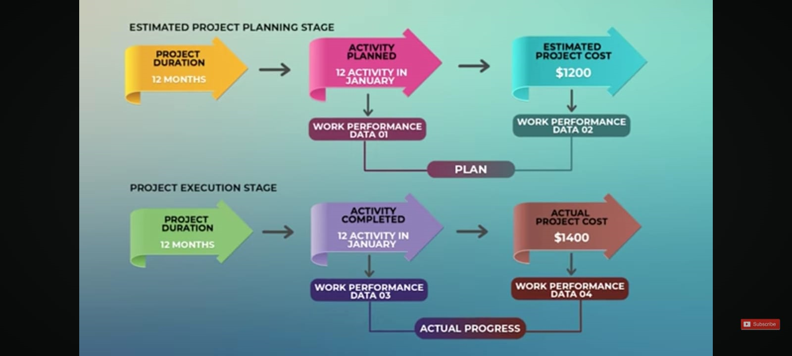
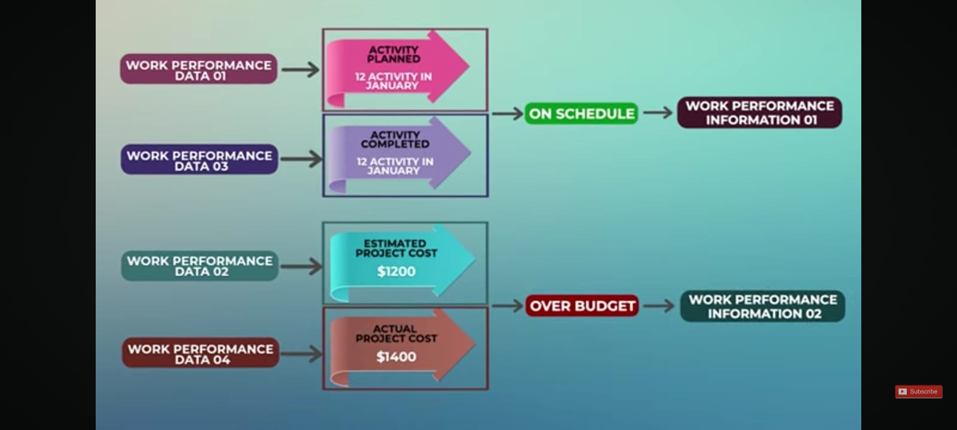

Slide 29


Slide 30
3 PERFORM INTEGRATED CHANGE CONTROL: OUTPUTS
1 APPROVED CHANGE REQUESTS
Approved change requests will be implemented through the Direct and Manage Project Work process. Deferred or rejected change requests are communicated to the person or group requesting the change.
The disposition of all change requests is recorded in the change log as a project document update.
2 PROJECT MANAGEMENT PLAN UPDATES
3 PROJECT DOCUMENTS UPDATES
A project document that is normally updated as a result of this process is the change log. The change log is used to document changes that occur during a project.

Slide 31
Project Integration Management processes
Manage Project Knowledge—The process of using existing knowledge and creating new knowledge to achieve the project’s objectives and contribute to organizational learning.
Monitor and Control Project Work—The process of tracking, reviewing, and reporting overall progress to meet the performance objectives deﬁned in the project management plan.
Close Project or Phase—The process of ﬁnalizing all activities for the project, phase, or contract.

Slide 32
Reading Assignment
Chapter 4: Project Integration Management by PMBOK-Guide-6th-Edition-PMI
Manage Project Knowledge
Monitor and Control Project Work
Close Project or Phase

